Slide 1

Logic Gates
Arduino with C Programming
ELECTRICAL ENGINEERING AND COMPUTER SCIENCE, COLLEGE OF ENGINEERING AND PHYSICAL SCIENCES
Notes:
Updated 13 Jun 2024 by Noah Mulvaney

Slide 2
Goals
Learn different types of logic gates and their operations
Use these logic gates to turn on an LED when inputs are appropriate

Slide 3
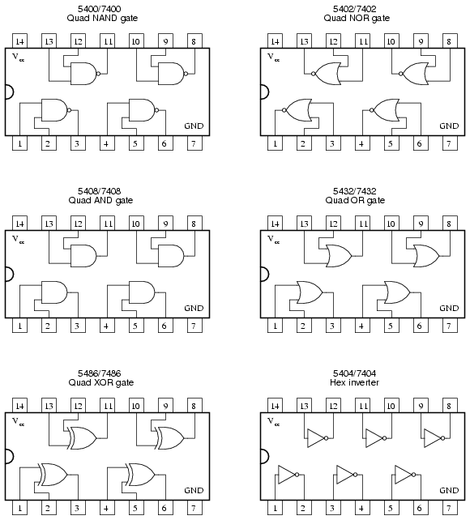
What are logic gates?
Logic gates are like the building blocks of computers. They help computers make decisions by controlling the flow of electricity.
You can think of them like little switches that turn on or off based on certain rules.
In this presentation we will be focusing on three basic gates, the AND, the NOR, and the NOT gate.

Slide 4
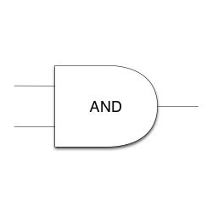
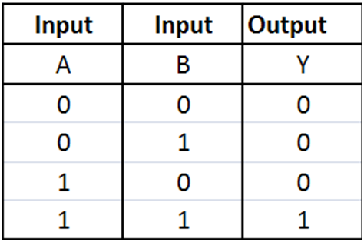
What is an AND gate?
A logic gate can either output HIGH or LOW, in our case HIGH is the voltage applied and LOW is ground.
For an AND gate to output HIGH, all inputs must be HIGH.
Each gate also has a symbol, the AND symbol is in the top right corner
1 is HIGH, and 0 is LOW
To represent the operation of the AND gate we use the multiplication sign (*)

Slide 5
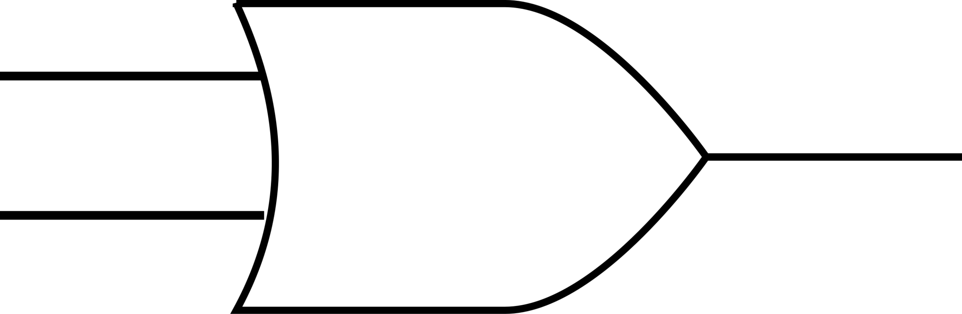
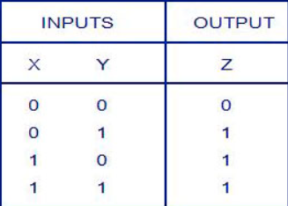
What is an OR gate?
An OR gate only requires one of the inputs to be HIGH , for a HIGH output
To represent the operation of the OR gate we use the addition sign
For example, A+B is A or B

Slide 6
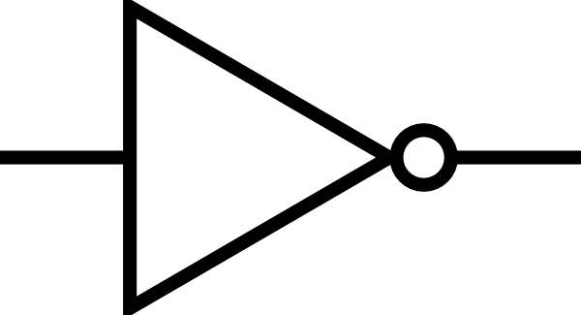
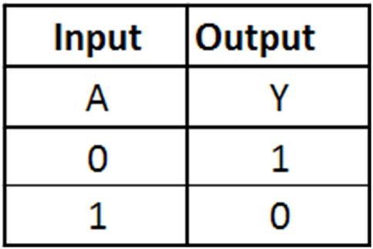

What is a NOT gate?
A NOT gate simply inverts the input given
For example, if the input is HIGH, then the output is LOW
To symbolize that we are inverting an input we can use a bar over the top of the letter or an exclamation mark before it
For example, !A, , and A’ are all equal to the opposite of A

Slide 7
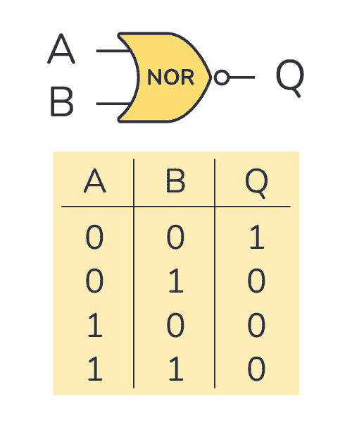
What is a NOR gate?
This gate does exactly the opposite of the OR gate, if any input is HIGH then the output is LOW
You can think of NOR as NOT OR, which gives us the expression !(A+B)

Slide 8
Using the IC logic gates
An IC is an integrated circuit, so an IC logic gate is a circuit that performs the operation of a certain logic gate
For each chip there are pins for inputs, outputs, and power
We can make a digital logic circuit to turn on an LED with logic gates

Slide 9
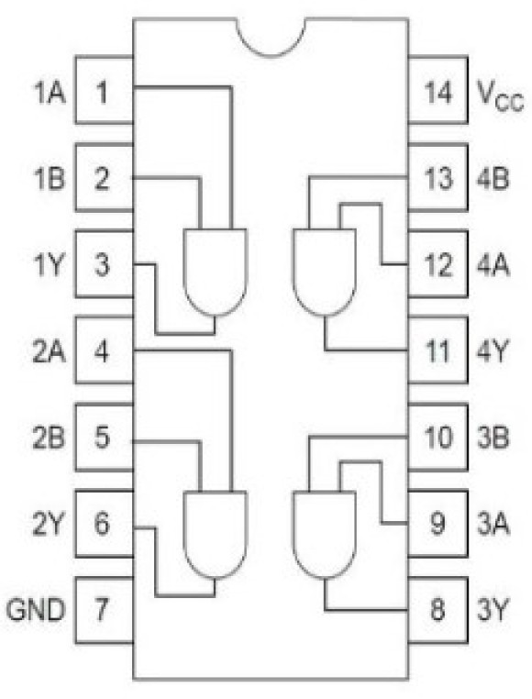
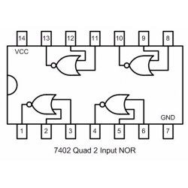
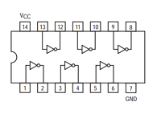
Pinouts
CD4081BE (AND gate)
SN74LS04N (NOT gate)
SN74HC02N (NOR gate)

Slide 10


Boolean Expressions
Y
We will be building our digital logic circuit based off the equation: Y = !((AB) + !C)
Our output Y will turn on an LED if the equation above is true so, combinations 2, 4, and 6 should light up the LED.
A truth table of this equation can be used to check our circuit
We could even build a truth table from a circuit just by looking at the LED with different inputs

Slide 11
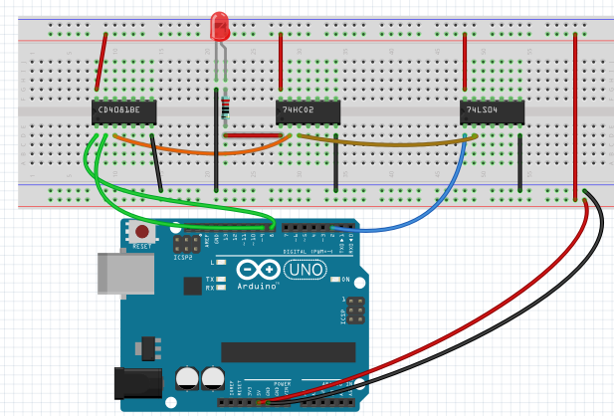
Circuit
220Ω
8
2
9

Slide 12
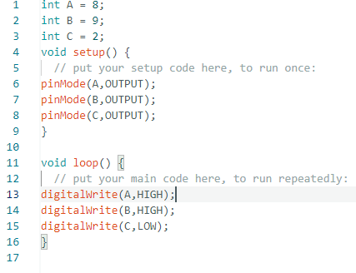
Coding
Create a new sketch and fill in the code below
Our digital pins are the inputs into our boolean equation
You can change the value of these pins and see what the corresponding output is

Slide 13
Coding
Instead of manually typing the inputs for A, B, and C, we can use for loops so that our program goes through all the possible combinations for us
All the possible combinations are in the truth table, from a few slides ago, we need to have these available for the program to loop through
Open the template ‘LogicGates_temp.ino’

Slide 14
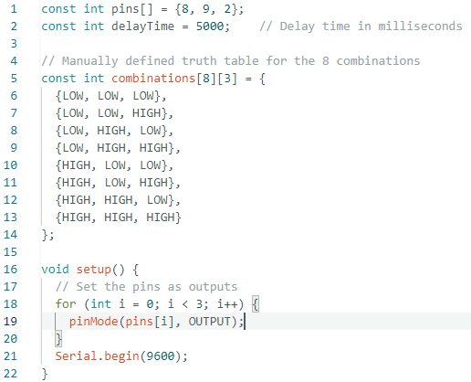
Coding

Slide 15
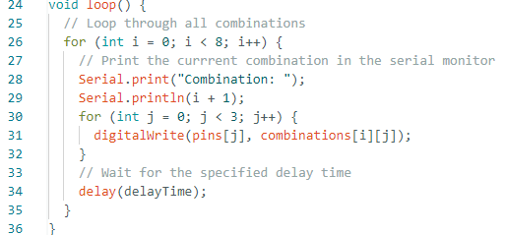
Coding

Slide 16


Test it Out!
Y
Open your serial monitor and observe which combinations turn on the LED. Verify with the truth table.

